Slide 1
Man
of the
Cross

Slide 2
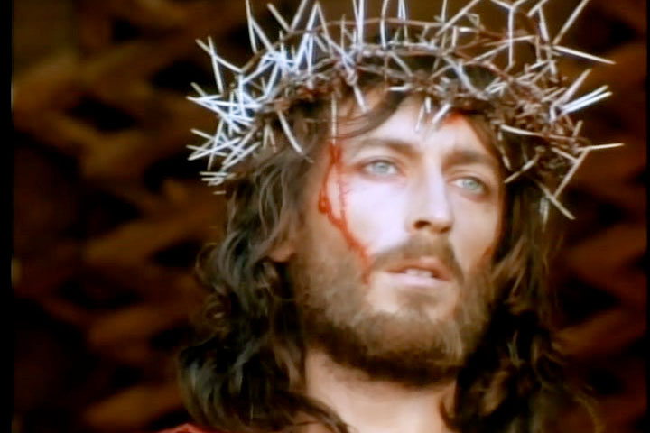
We walk with Jesus on his journey to Golgotha, in awe of the man who took upon Himself the sins of the world.
We walk in solidarity with the many who are sinned against today --
not in some far away corner of the globe, but right here, nearby, in our own homes.

Slide 3
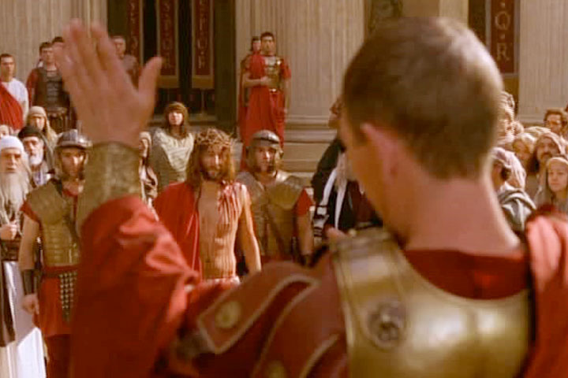
1st Station: Jesus is condemned to death
It is easy for Pilate to condemn Jesus to death; he does not see beyond the immediate need of placating the chief priests and scribes and the rowdy crowd. He wants peace at any cost. Jesus is just another addition to a list of people sacrificed on the altar of public fame and popularity.

Slide 4
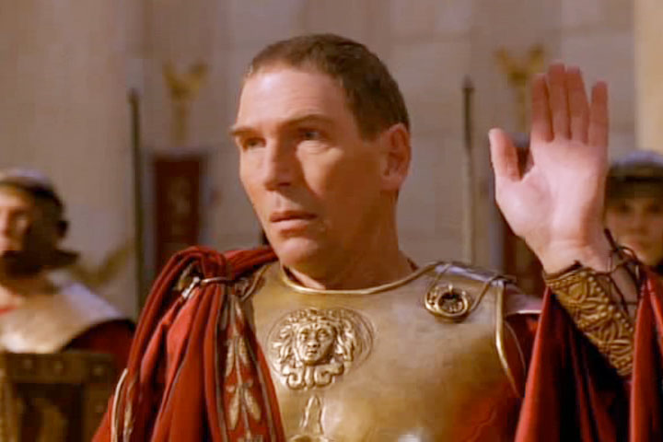
1st Station: Jesus is condemned to death
But we do this even today. We are so quick to judge and to condemn those who are different from us; we do not want to encounter “dangerous” people who may challenge us to change from our selfish ways.

Slide 5
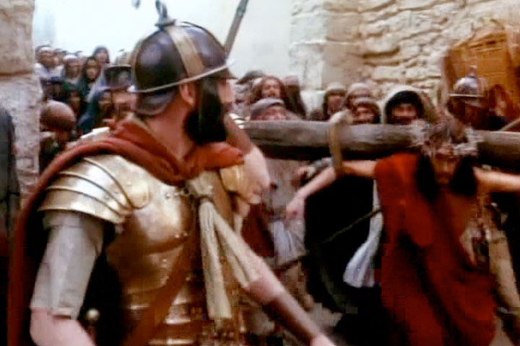
2nd Station: Jesus carries His Cross
The heavy Cross on his shoulders was meant to shame Jesus in front of the crowd. It meant that he was marked out for ridicule and a humiliating death. It gave license to anyone in the crowd who wanted to taunt him and rail at him. It was an outlet for violence.

Slide 6
2nd Station: Jesus carries His Cross
The Cross in our lives today may not be visible to others e.g. illness, problems of money, employment, etc. It may even include living with a family member who is difficult to deal with. We are challenged by Jesus to carry our cross with love. Let us pray for the grace to carry our cross.

Slide 7
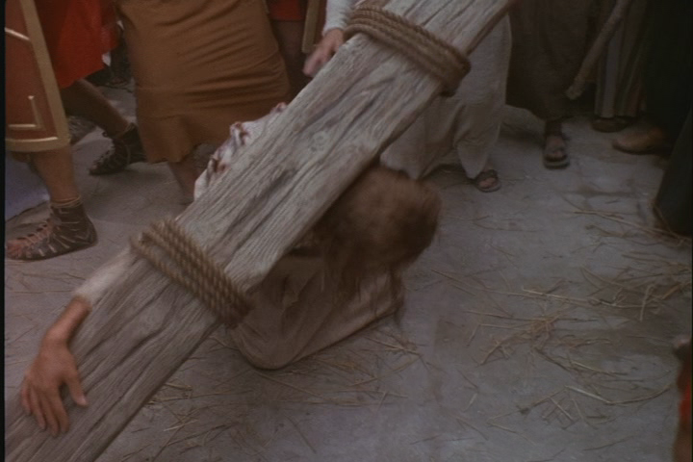
3rd Station: Jesus falls for the first time
The weight of the Cross has sapped his energy; Jesus falls to the ground, bruised and bloody. The onlookers and soldiers jeer at him; the soldiers whip him and drag Him up again. No mercy is shown to the Most Merciful One – the prince of Peace.

Slide 8
3rd Station: Jesus falls for the first time
The falls are painful – even when no one is looking at us. We want to be assured of success in life; failure is not an option. The recent coronavirus pandemic indicates the difficulty of facing the unknown, and the increasing move towards a world on the brink of despair. Let us pray that those burdened with despair may rise again.

Slide 9
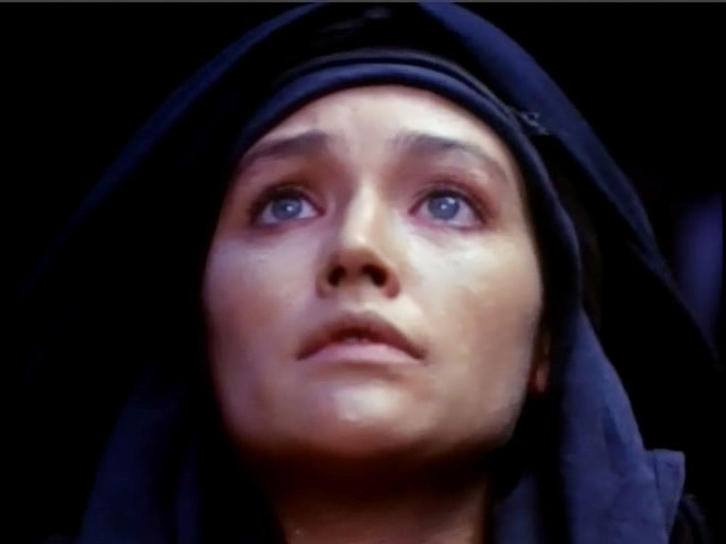
4th Station: Jesus meets His mother
The compassion in Mary’s eyes and the silent conversation that flowed between mother and son were beyond the understanding of the mob.
His mother understands – she feels with and suffers with Jesus.

Slide 10
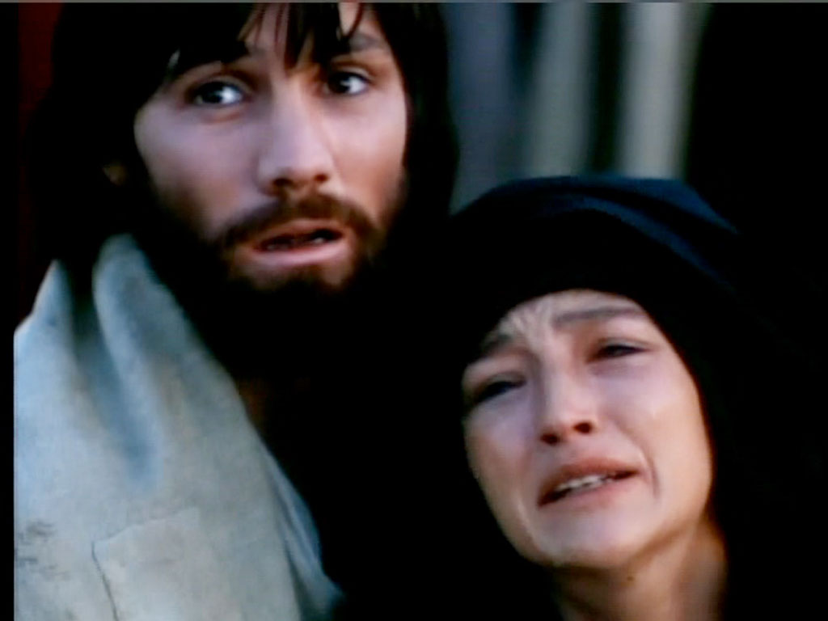
4th Station: Jesus meets His mother
The suffering of children wounds the hearts of the parents. There is so much that we can learn from Mary who indicated that she was near to Jesus in His hour of need.

Slide 11
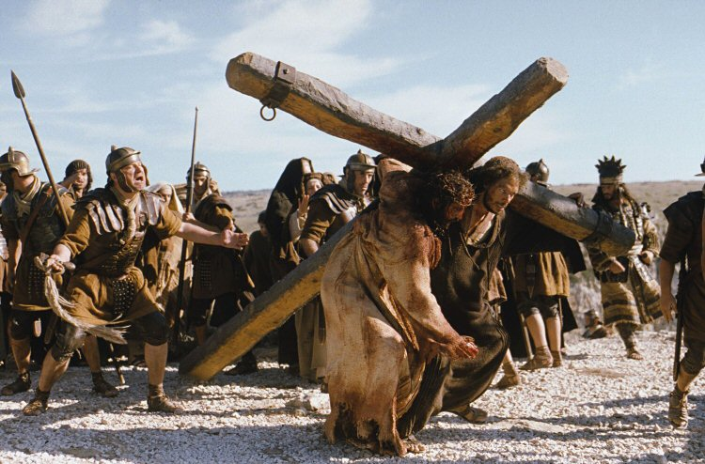
5th Station: Simon helps Jesus carry His Cross
Simon of Cyrene is forced to help Jesus, and yet he is not feeling angry. He is slowly becoming a willing participant in the drama that is unfolding – the salvation mystery becoming a reality.

Slide 12
5th Station: Simon helps Jesus carry His Cross
We have opportunities to do good and to help others around us. But we must first be willing to see their struggle; our hearts must be touched by their pain. We can do a lot, if only we are not concerned about who gets credit.

Slide 13
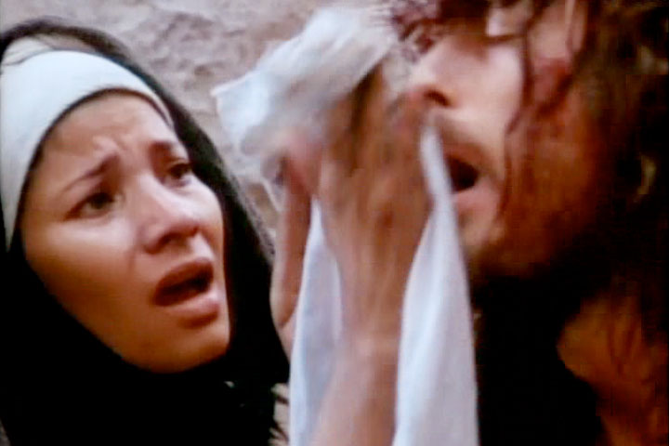
6th Station: Jesus meets Veronica
Veronica is the woman who reached out to Jesus, in spite of the mob and the soldiers. She did not think of the consequences of her act of compassion. She was moved by something bigger than fear.

Slide 14
6th Station: Jesus meets Veronica
We are often held back by fear of the consequences. ‘What would happen if I…?’ There are so many opportunities to do good, to stand up for what is right, but we let them pass, because we are afraid of public sentiment, of others’ comments.

Slide 15
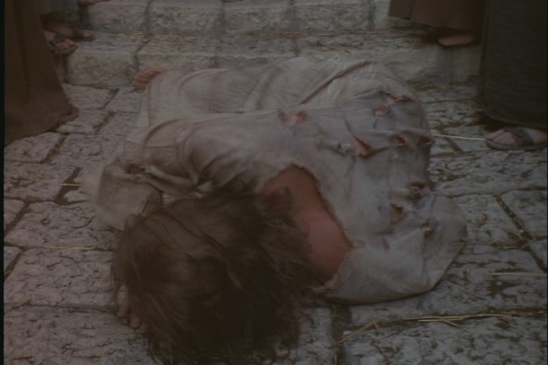
7th Station: Jesus falls for the second time
The burden of the Cross is weighing Him down and Jesus falls again. His ordeal is telling on Him – the scourging, the lack of sleep and most of all, the uphill climb under the weight of the Cross. But he gets up again and continues on the way to Golgotha.

Slide 16
7th Station: Jesus falls for the second time
We can see people who are afflicted who are struggling to survive. They are driven by a desire to overcome their suffering. And there are several who will give up. Their complaint will be: “It was not within my reach.” They are discouraged and giving up on life. We pray that they may remember that their very breath is itself a sign of hope.

Slide 17
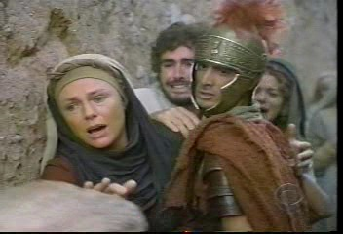
8th Station: Jesus meets the women of Jerusalem
The women of Jerusalem have pity for Jesus; he has been a familiar figure, a person they have seen and heard. But he leaves them with a worrying thought: What will happen to them if this is how Jesus Himself is treated?

Slide 18
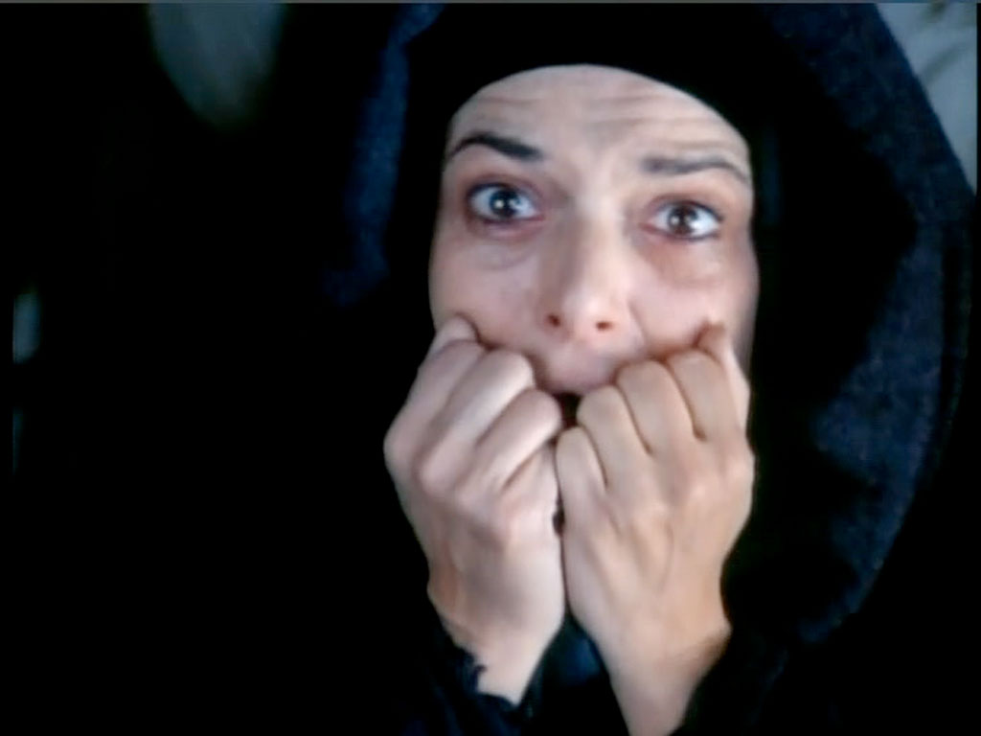
8th Station: Jesus meets the women of Jerusalem
As we look around, we see that women are often at the receiving end of strife. They are used and abused to settle scores between families and nations at war.
The life of a woman is so fragile and yet, she is cheerful and life-giving.
We are challenged to see what we can do to make her life more fulfilling.

Slide 19
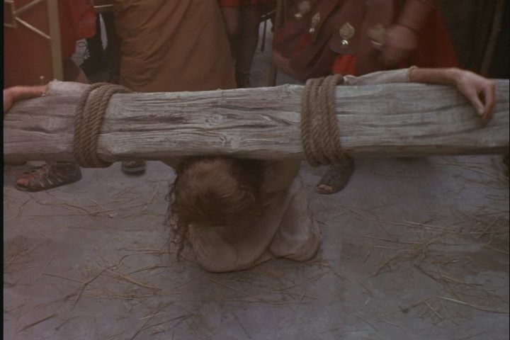
9th Station: Jesus falls for the third time
The third fall of Jesus is a result of His failing strength. It must have been more painful to stand up this time, but he does, giving us an example for our own lives. Nothing is finished till it actually is.

Slide 20
9th Station: Jesus falls for the third time
We are tempted to think of failure as a setback, and some of us count our failures instead of our blessings. The temptation to wallow in self-pity must be replaced by the determination to rise above our failures. When we are in desperate situations, let us keep our eyes on Jesus.

Slide 21
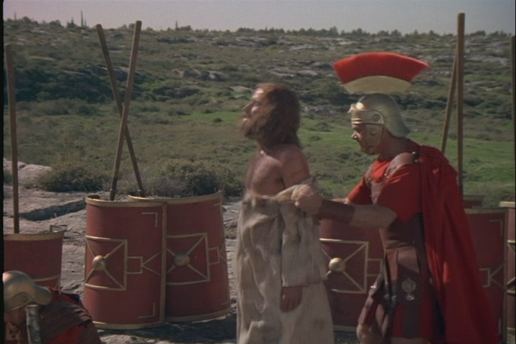
10th Station: Jesus is stripped of His garments
The painful walk to Golgotha is now made worse by the wrenching of His garments from His blood-soaked body. He who made the entire universe is stripped of His dignity, left open to the rude gaze of His creation. He is giving up everything.

Slide 22
10th Station: Jesus is stripped of His garments
We see this happening in various parts of the world – the stripping of people’s clothes as an act of revenge and a way to bring their self-respect to naught. We see this also in stripping people of their reputation through gossip and slander. We are unable to control this method of tearing down their self-respect.

Slide 23
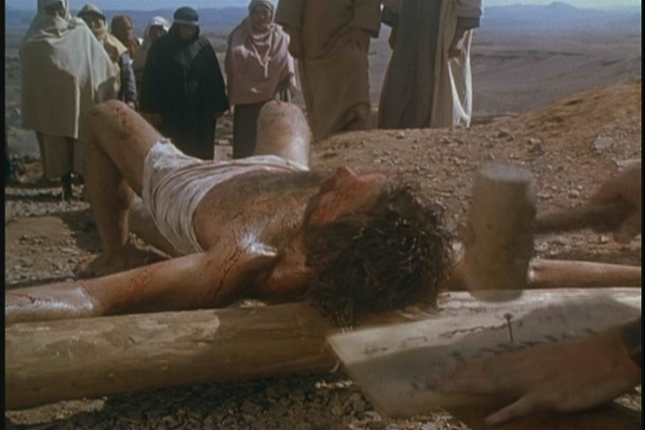
11th Station: Jesus is nailed to the Cross
The end is nearing. . . The painful end. The nails are hammered into His hands and legs, bringing forth fresh waves of pain and blood pouring out. His whole body is now a mass of flesh racked by pain. But He is still clear in His thinking: “Father, forgive them, they know not what they do.”

Slide 24
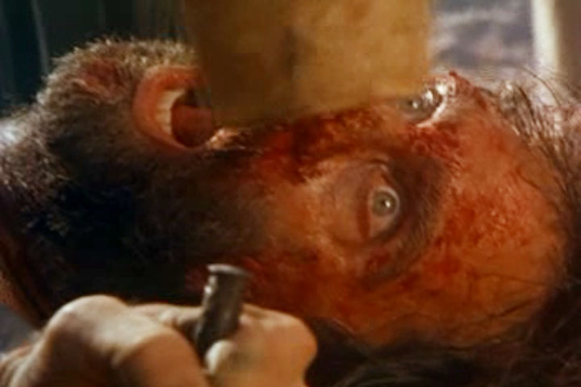
11th Station: Jesus is nailed to the Cross
We are moved by Jesus’ pain. He asks us to look around us and be moved by those who scavenge in dustbins for food, for those whose children will die for want of medical aid, for those who are struggling to find their dignity as human beings. He challenges us to do something to alleviate pain and suffering in the world around us.

Slide 25
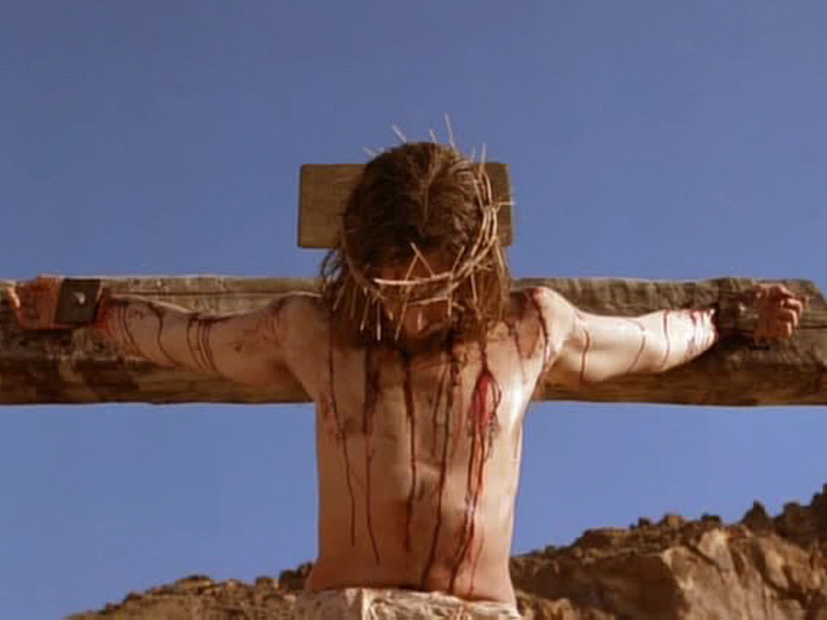
12th Station: Jesus dies on the Cross
The hour has come! Jesus dies on the Cross. For the onlookers, it is the end of the drama. It is actually the TRANSITION: death is no longer victorious over mankind. We are no more shackled by original sin. Jesus is our BRIDGE to the Father and to life eternal.

Slide 26
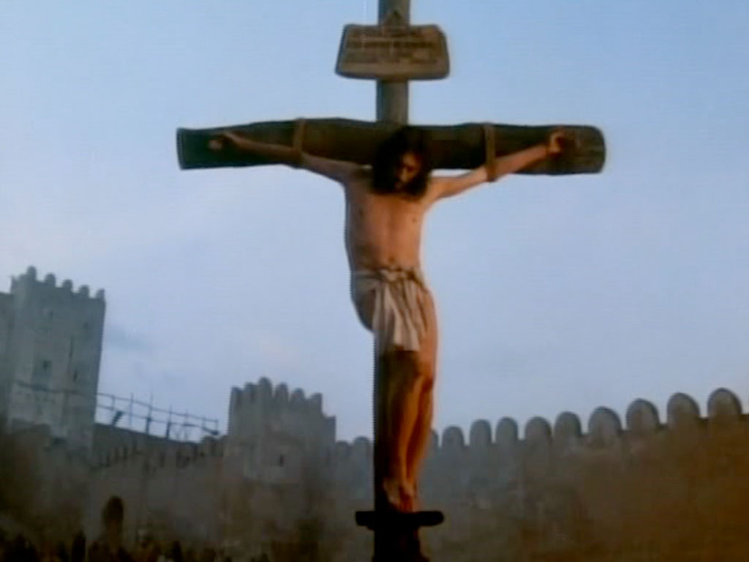
12th Station: Jesus dies on the Cross
We see death staring us in the face each day, as illness, terrorism and accidents are commonplace. Each day, we are faced with situations in which the hand of God protects us. We are often too busy to notice that hand. Let us pray for the grace to recognize God’s guiding and protecting hand in our lives.

Slide 27
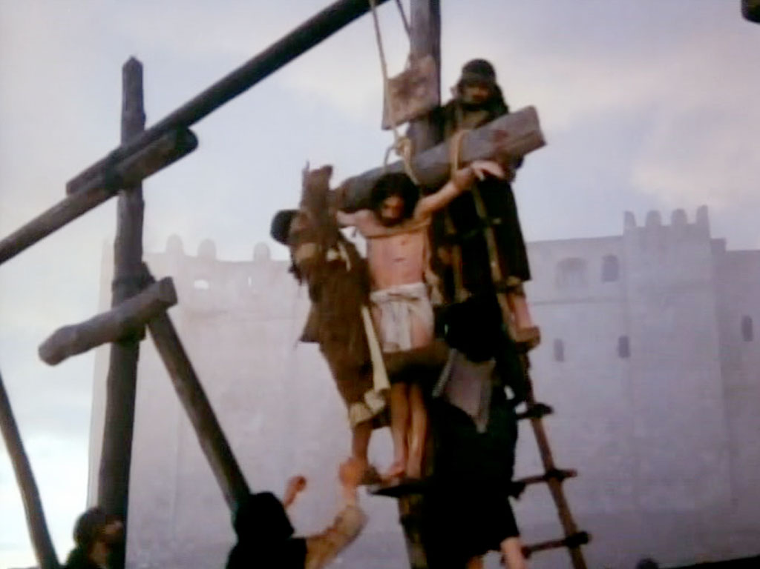
13th Station: Jesus is taken down from the Cross
The lifeless body of Jesus is brought down from the Cross. His mother receives her son. She is playing back all she has been pondering over the years since his conception.

Slide 28
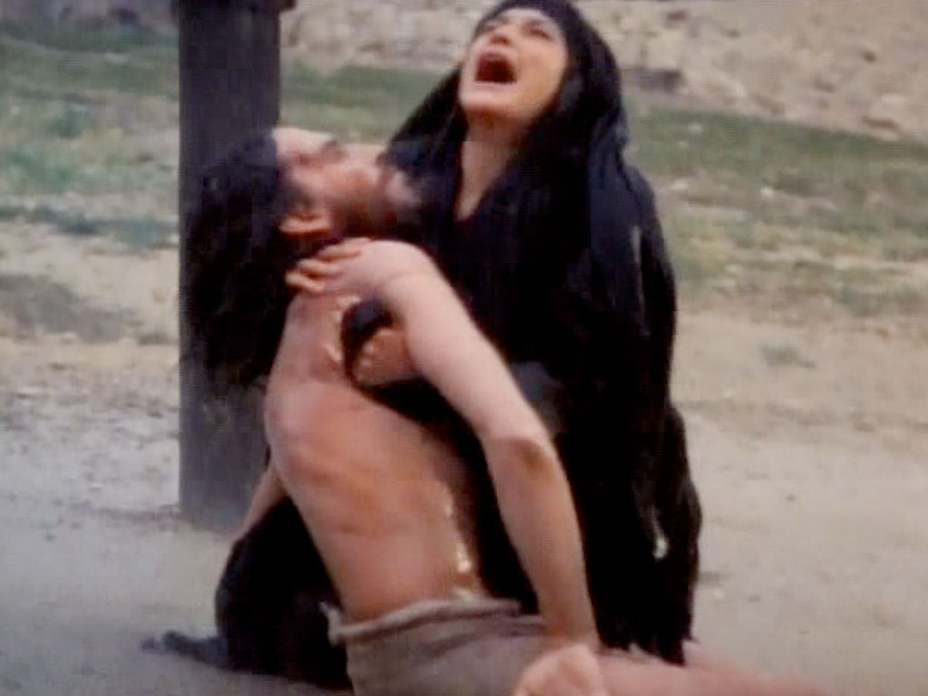
13th Station: Jesus is taken down from the Cross
We have seen many mothers and fathers who have to handle the grief of seeing their child die. It is a task that breaks them, makes them wonder about the existence of God, makes them question their faith. It needs courage and God’s grace to accept the situation.

Slide 29
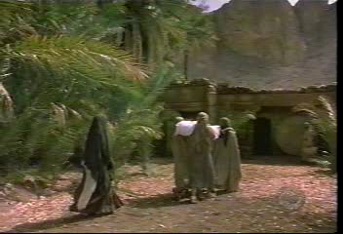
14th Station: Jesus is buried; He will rise again
The stone is rolled across the tomb, like the last stop. All is over. The apostles have run away; the disciples whisper in hushed voices. This is a different Passover for those closest to Jesus.

Slide 30
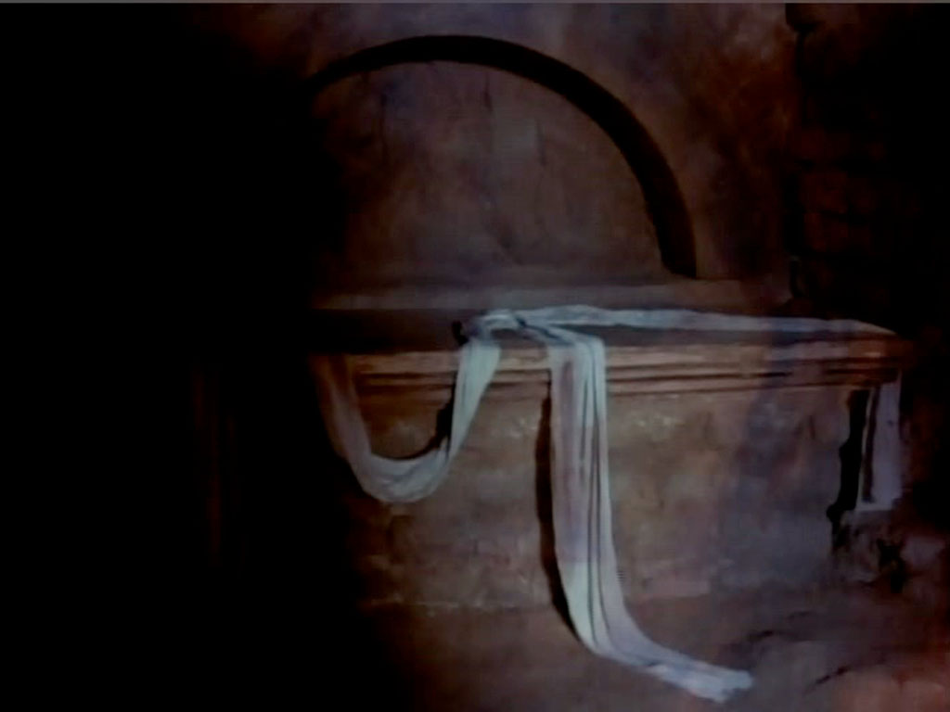
14th Station: Jesus is buried; He will rise again
We are challenged to look beyond the obvious.
There is a silver lining to every dark cloud; but we must look for it.
Jesus has ensured that we have eternal life,
but we must live our present life to the fullest.
We cannot rest
till his kingdom of justice,
love and peace
is a reality on earth.
We have a mission!

Slide 31
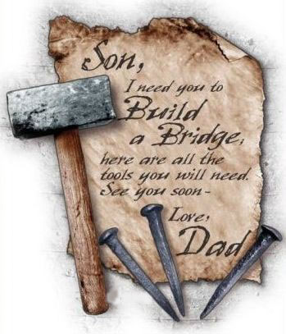
Thank you Lord, for sharing our human existence – our struggles, our pain, our fears, and even death itself.
Be with us in our sufferings.
As we have followed your painful journey to Calvary,
may we witness to you by lives of prayer, love and service, so that we can share your Easter victory.

